Slide 1
MODEL GUIDE BOOK

Slide 2
CONTENT
None included image classification model:
Data required
System setup
Import drive
Model setup and Testing
Object Detection Model
Introduction
Model setup and testing

Slide 3
Data Required
The image classification model needs image dataset of the classes(house, vehicle, tv, etc.) in a proper format as described below:
IMAGE DATASET:
CHAIRS:
PLASTIC CHAIRS:
IMG 1
IMG 2
IMG 3
WOODEN:
NONE:
MOBILE
FEATURE PHONE:
SMART PHONE:
NONE:
LAND
AGRICULTURAL:
URBAN:
NONE:
The link to image dataset directory can be found here image link. Open the link, go to the options menu and click on “Add Shortcut to Drive”. The dataset will be added to your system.(You need a google account)

Slide 4
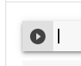
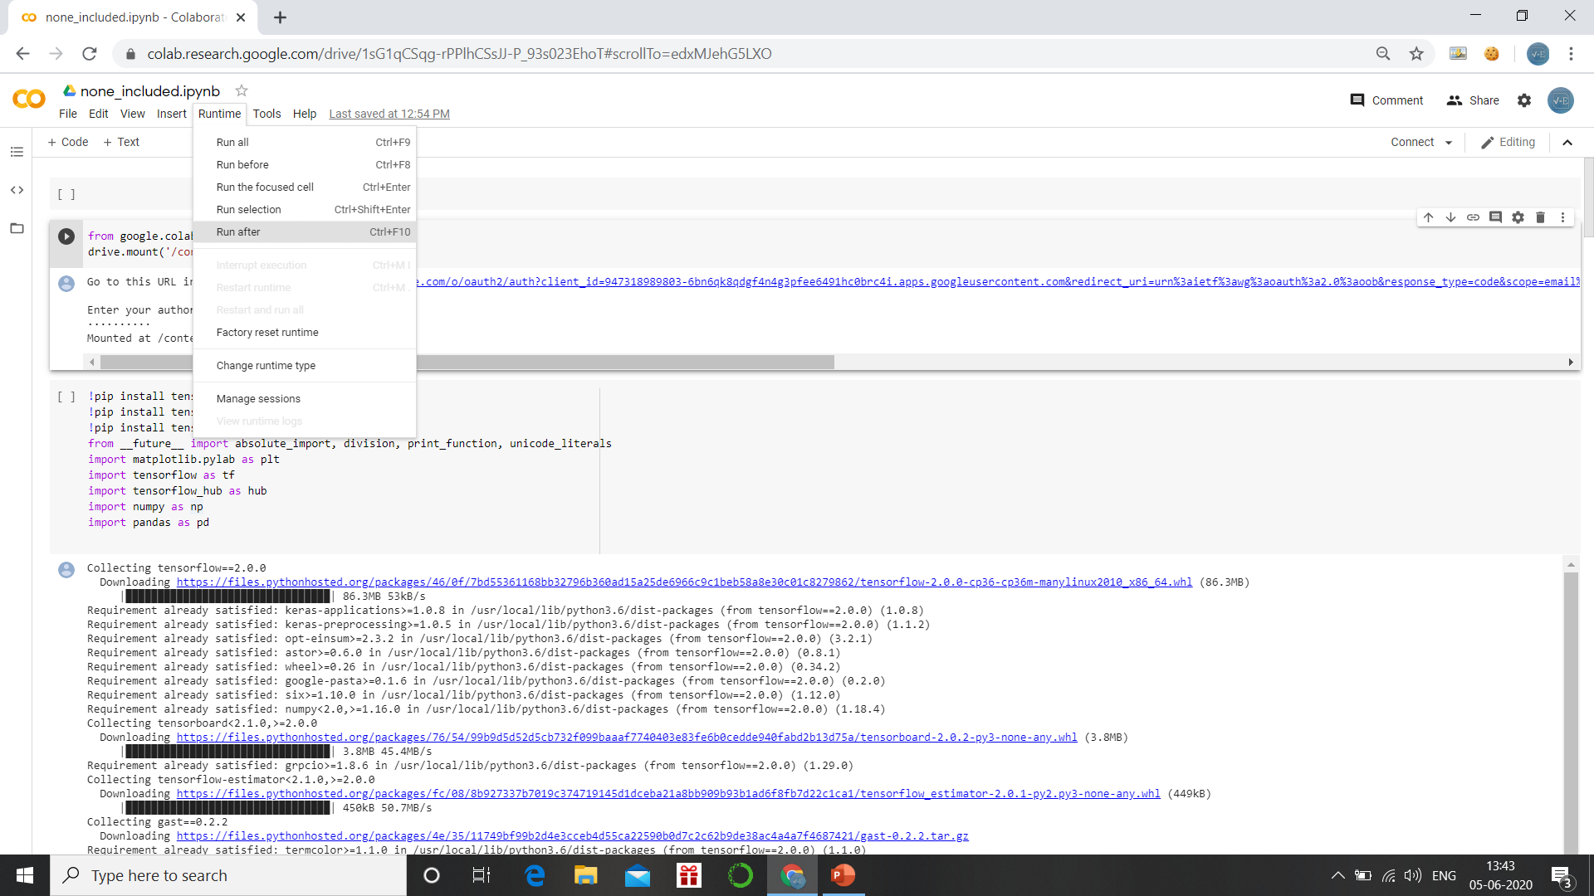
System Setup:
To run the model you need Google Colab, follow the link to open Colab.
You need to upload the none_included.ipynb file on your Colab window.
Here are ways by which you can run a code cell in google Colab.
To run a single code cell press ‘shift + enter’ simultaneously or click on this play button before the cell.
To run the entire notebook at once, select the code block go to Runtime in toolbar and then select Run After.
Colab is an interactive platform, whenever the system needs your input, it will pop the same below the code block.

Slide 5
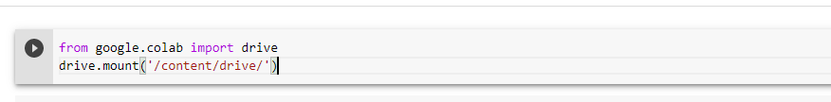
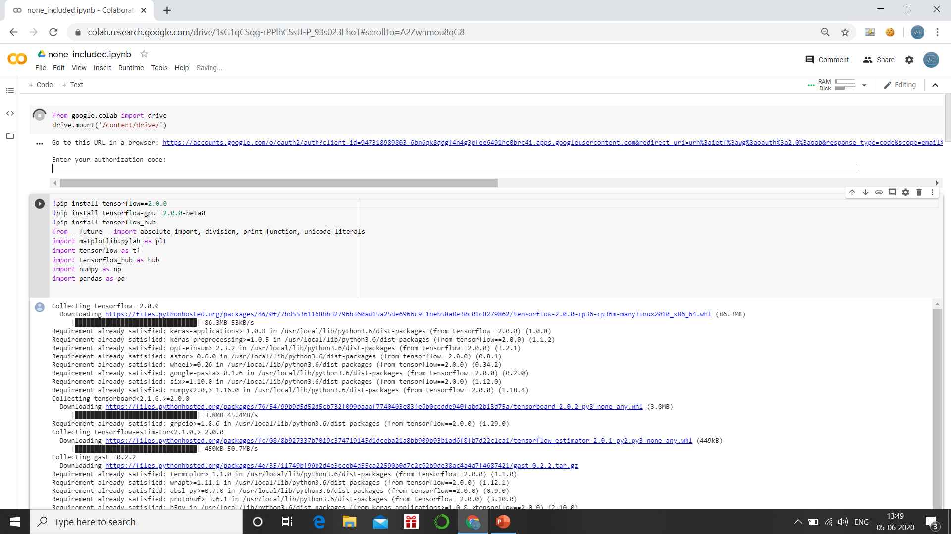
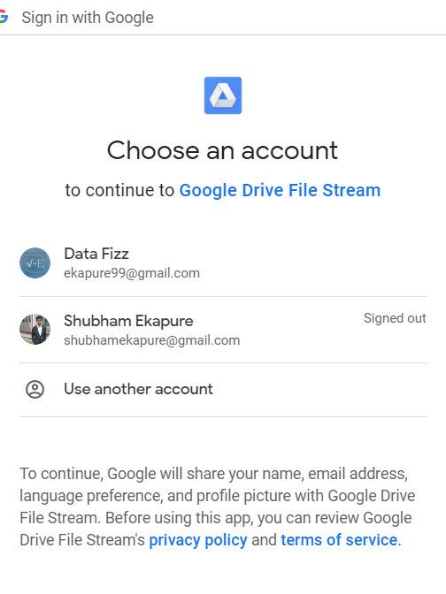
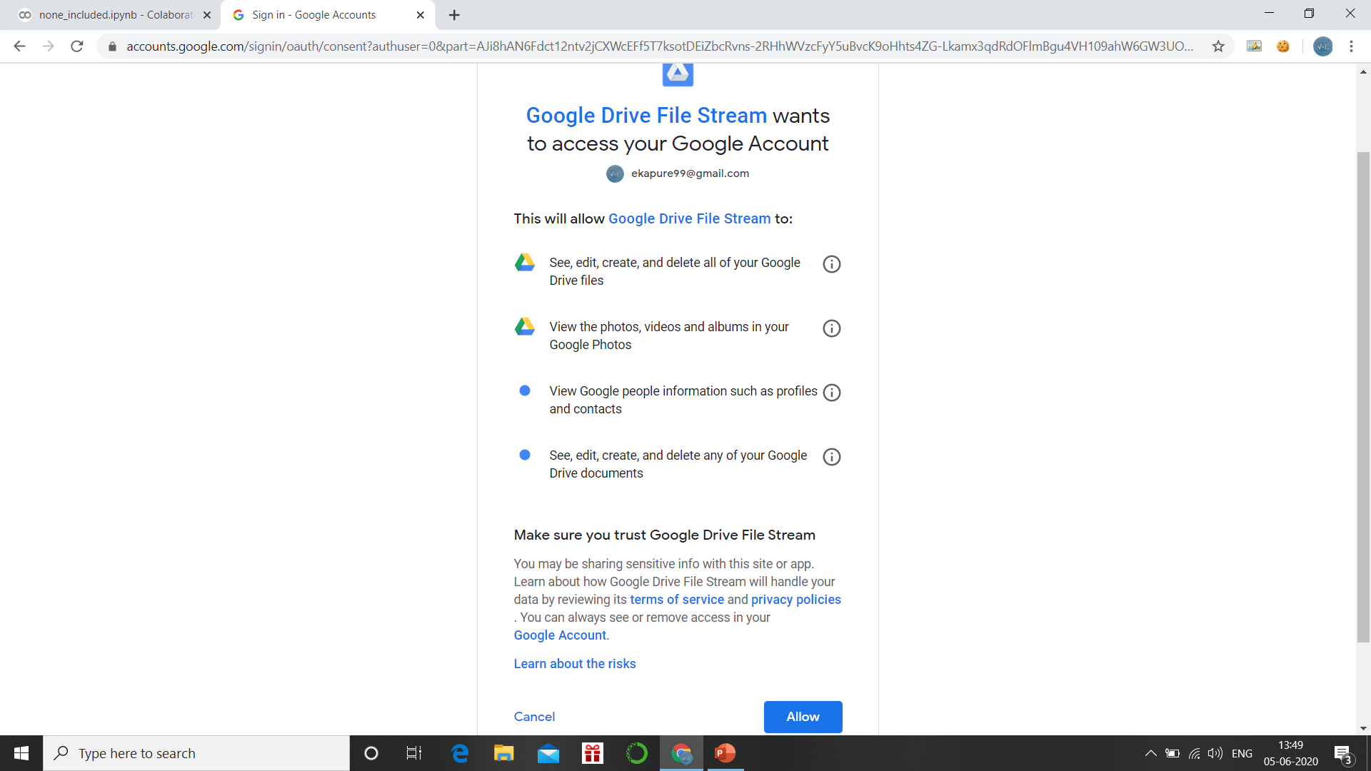
Import Drive
Adding shortcut to your drive is a one time thing, you don’t need to do it every time . But whenever you run the model you need to import your drive in google Colab so that it can fetch the image data. Please follow the steps below:
Run the code cell at the top:
Click on the blue link that pops below ahead of ‘Go to this URL in a browser:’:
Select the account then Allow access

Slide 6
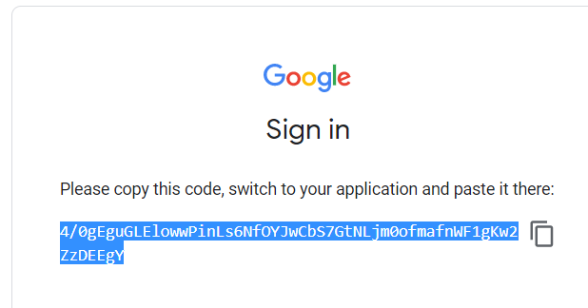
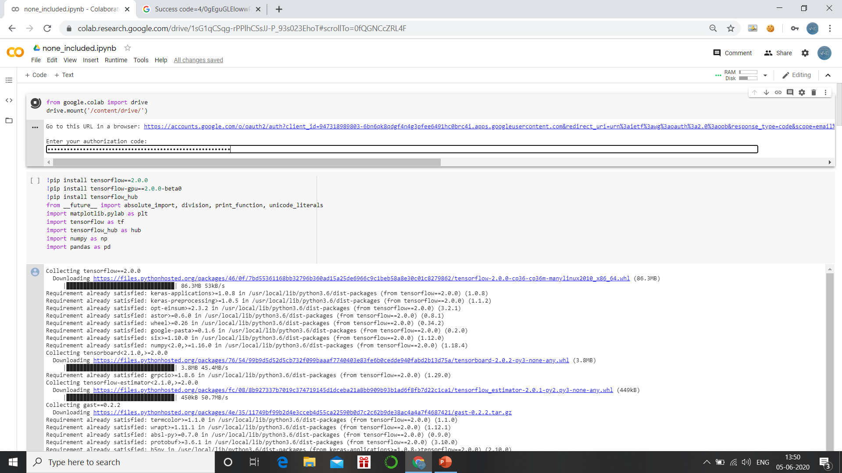
After allowing access, you will be taken to a new window with some access code copy that code:
Go back to the Colab window, paste the activation code and press enter:
With this the drive will be mounted on your system. Whenever you open Colab you need to import the drive so that you can access data.
You don’t need to do this if you want to re-run the model. You can directly start from path = ‘…’ cell. This will be discussed later

Slide 7
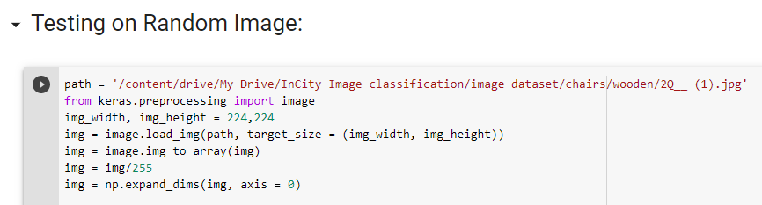
Model Setup & Testing
Once the drive has been imported, select the code cell below it and go to Runtime followed by Run After.
The model gets trained and validated after this step. It may take some time between 5-15 minutes depending upon the class of image being used.
For testing the model on random images, you need to go to upload section, select an image from your PC, once uploaded you need to copy it’s path and paste it in ‘path’ cell present below ‘Testing on Random Image:’ section.
Run this cell by clicking the play button and it will give the results.

Slide 8
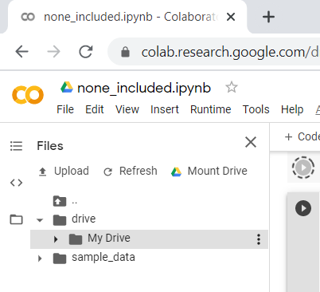
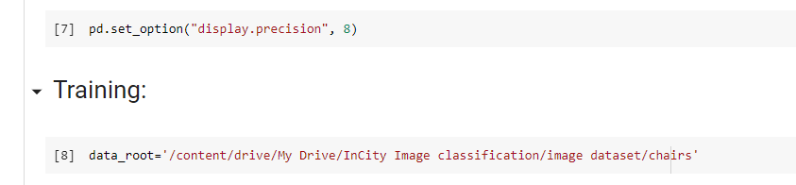
If you want to train the model for some other image category, follow the steps below:
Go to folder icon in the leftmost area, then
Drive>>My Drive>>image dataset>>class
Copy the path of class you want to train your model on, paste it in code cell data_root present just below the Training section.

Slide 9
Object Detection Model
INTRODUCTION
Object Detection API provided by TensorFlow on GitHub is used. The model is imported an trained from GitHub.
To open the model file and run it follow the same steps described above for image classification model.
The model is built based on the article provided by Chengwei named ‘How to train an object detection model easy for free’. Follow this link to go to the tutorial: LINK
The articles has all the details for a deeper understanding of the model. Anyways few steps for model setup and testing are discussed ahead.

Slide 10
Model Setup & Testing:
Open the Colab notebook via link or manually.
Go to runtime followed by run after, wait for the model to train entirely.
You can see the results in the last and the second last code cell.
To get pictorial results with bounding boxes, go to the third last cell of the model which begins with:
%cd /content/models/research/object_detection
Run this third block again, to test your own images you need a GitHub account, go to this GitHub link, fork the repository, go to the folder test and add images which you want to test the model upon.
GitHub Link: HERE
Notebook Link: HERE

